Slide 1

Version 2, Oct 2023
Phonics
Syllable division: two-syllable words with a VC/CV pattern
Instructions for teachers are included in the ‘notes’ section under each slide.

Slide 2
Notes for teachers
These slides show a sample of a systematic synthetic phonics lesson incorporating syllable division for two-syllable words with a vowel-consonant/consonant-vowel (VC/CV) pattern. The slides contain the following steps, aligned with an explicit instruction model:
1. Set learning intention and success criteria with students. (Slide 4)
2. I do: the teacher models using the target VC/CV pattern in a two-syllable word to assist with syllable division. (Slide 5)
3. We do: the teacher and students use the target VC/CV pattern in two-syllable words to assist with syllable division. (Slide 6)
4. I do: the teacher models decoding two-syllable words with the target VC/CV pattern. (Slides 7–9)
5. We do: the teacher and students decode two-syllable words with the target VC/CV pattern. (Slides 10–12)
6. I do: the teacher models encoding two-syllable words with the target VC/CV pattern. (Slides 13–15)
7. We do: the teacher and students encode two-syllable words with the target VC/CV pattern. (Slides 16–18)
8. I do: the teacher reads and spells a new irregular word. (Slide 19)
9. We do: the students read and spell the new irregular word. (Slide 20)
10. I do: the teacher models decoding a sentence containing two-syllable words with the target VC/CV pattern. (Slide 21)
11. We do: the teacher and students decode a sentence containing two-syllable words with the target VC/CV pattern. (Slide 22)
12. I do: the teacher models writing a sentence containing two-syllable words with the target VC/CV pattern. (Slide 23)
13. We do: the teacher and students write a sentence containing words with the target VC/CV pattern. (Slide 24)
14. Check for understanding: students demonstrate their understanding by completing a task on a whiteboard or worksheet using the skills they have just learned. The teacher monitors to ensure understanding. (Slides 25–26)
15. You do: students complete an independent activity to apply the skills they have just learned. (Slide 27)

Slide 3







When you see these icons…
The teacher explicitly teaches and models (I do).
Students have something to fill out/write/draw.
The teacher guides students and provides immediate feedback (We do).
Students have something to look at/read.
‘Chin it’: students apply their learning by writing on a mini-whiteboard or worksheet or equivalent. They hold this under their chins so the teacher can monitor for student understanding.
Students apply their knowledge independently (You do).
Print a class set of worksheets to accompany this lesson: https://tinyurl.com/2hfvufme

Slide 4
We are learning to read and write two-syllable words.
Learning intention
Success criteria
I will know I have been successful if I can:
- identify a VC/CV pattern in a two-syllable word
- read two-syllable words with a VC/CV pattern
- write two-syllable words with a VC/CV pattern.
Notes:
The vowel-consonant (VC) pattern introduced in this lesson is vowel-consonant/consonant-vowel (VC/CV). Identifying this pattern will help us divide two-syllable words into two closed syllables for reading and spelling.
Syllable type pattern
Two closed syllables in a two-syllable word with a VC/CV pattern.
The irregular word in this lesson is ‘walk’. Irregular words are words containing letter–sound correspondences that students have not yet learned. These should be included as part of lessons, as students will need them early in their reading and writing development. The reading and writing of irregular words is not the primary focus for this lesson, so is not included in the success criteria.

Slide 5

I do…
V C /
C V
w o m/b a t
Notes:
Edit the grapheme to your preferred font.
Demonstrate identifying the VC/CV pattern in the word wombat.
We always start at the first vowel in the word. Split between the two consonants in the word. We have now made two closed consonants: w-o-m wom and b-a-t bat. If we blend those two syllables together, we get the completed word wombat.

Slide 6
We do…
/
V C C V
s u d d e n
/
/
V C C V
/
b a n d i t
/
V C C V
/
p r o b l e m
Notes:
Edit the grapheme to your preferred font.
With student assistance, identify the VC/CV pattern in the word sudden.
We always start at the first vowel in the word. Split between the two consonants in the word. We have now made two closed consonants: s-u-d sud and d-e-n den. If we blend those two syllables together, we get the completed word sudden.
Repeat with the words bandit and problem.

Slide 7
I do…
contest
Notes:
Demonstrate identifying the VC/CV pattern in the word contest.
We always start at the first vowel in the word. Split between the two consonants in the word. We have now made two closed consonants: c-o-n con and t-e-s-t test. If we blend those two syllables together, we get the completed word contest.

Slide 8
I do…
contest happen
Notes:
Demonstrate identifying the VC/CV pattern in the word happen.
We always start at the first vowel in the word. Split between the two consonants in the word. We have now made two closed consonants: h-a-p hap and p-e-n pen. If we blend those two syllables together, we get the completed word happen.

Slide 9
I do…
contest happen tablet
Notes:
Demonstrate identifying the VC/CV pattern in the word tablet.
We always start at the first vowel in the word. Split between the two consonants in the word. We have now made two closed consonants: t-a-b tab and l-e-t let. If we blend those two syllables together we get the completed word tablet.

Slide 10

We do…
magnet
Notes:
With student assistance, identify the VC/CV pattern in the word magnet.
We always start at the first vowel in the word. Split between the two consonants in the word. We have now made two closed consonants: m-a-g mag and n-e-t net. If we blend those two syllables together, we get the completed word magnet.

Slide 11
We do…
magnet cobweb
Notes:
With student assistance, identify the VC/CV pattern in the word cobweb.
We always start at the first vowel in the word. Split between the two consonants in the word. We have now made two closed consonants: c-o-b cob and w-e-b web. If we blend those two syllables together, we get the completed word cobweb.

Slide 12
We do…
magnet cobweb puppet
Notes:
With student assistance, identify the VC/CV pattern in the word puppet.
We always start at the first vowel in the word. Split between the two consonants in the word. We have now made two closed consonants: p-u-p pup and p-e-t pet. If we blend those two syllables together, we get the completed word puppet.

Slide 13

I do…
Notes:
The image represents the word to be written: kitten.
Demonstrate saying the word and then splitting it into two syllables: kit/ten. Model segmenting each sound in the first syllable and writing the letters that represent them. Repeat with the second syllable.
Re-read the completed word to check it is correct and to make sure it has the VC/CV pattern.

Slide 14

I do…
Notes:
The images represent the words to be written: kitten, laptop.
Demonstrate saying the new word and then splitting it into two syllables: lap/top. Model segmenting each sound in the first syllable and writing the letters that represent them. Repeat with the second syllable.
Re-read the completed word to check it is correct and to make sure it has the VC/CV pattern.

Slide 15

I do…
Notes:
The images represent the words to be written: kitten, laptop, muffin.
Demonstrate saying the new word and then splitting it into two syllables: muf/fin. Model segmenting each sound in the first syllable and writing the letters that represent them. Repeat with the second syllable.
Re-read the completed word to check it is correct and to make sure it has the VC/CV pattern.

Slide 16

We do…
Notes:
The image represents the word to be written: tennis.
Students participate in saying the word and then splitting it into two syllables: ten/nis. Model segmenting each sound in the first syllable and writing the letters that represent them. Repeat with the second syllable.
Re-read the completed word to check it is correct and to make sure it has the VC/CV pattern.

Slide 17

We do…
Notes:
The images represent the words to be written: tennis, sunset.
Students participate in saying the new word and then splitting it into two syllables: sun/set. Model segmenting each sound in the first syllable and writing the letters that represent them. Repeat with the second syllable.
Re-read the completed word to check it is correct and to make sure it has the VC/CV pattern.

Slide 18

We do…
Notes:
The images represent the words to be written: tennis, sunset, trumpet.
Students participate in saying the new word and then splitting it into two syllables: trum/pet. Model segmenting each sound in the first syllable and writing the letters that represent them. Repeat with the second syllable.
Re-read the completed word to check it is correct and to make sure it has the VC/CV pattern.

Slide 19
I do…
walk walk walk
Notes:
Demonstrate the following steps to draw students’ attention to the internal structure of the irregular word, including letter–sound correspondences that have not yet been taught.
Tell students the word you are going to spell.
Use the word in a sentence for context, for example, ‘I took the dog for a walk.’
Say each sound in the word.
On your teacher whiteboard, draw a short horizontal line for each sound in the word.
Write the corresponding letter on each sound line.
Circle the irregular part of the word, in this case the letters alk in ‘walk’.
Spell the word orally, for example, ‘w-a-l-k spells walk.’

Slide 20
We do…
walk walk walk
Notes:
Prompt students to complete the process with you.
Tell students which word they are going to spell.
Use the word in a sentence.
Say the sounds.
Draw the sound lines.
Add the letters.
Circle the irregular part.
Spell the word.

Slide 21
I do…
We had a picnic at sunset.
Notes:
Model segmenting and blending sounds to read each word in the sentence.
For two-syllable words:
identify the VC/CV pattern
split the word into two closed syllables
blend the sounds to read each syllable
blend the syllables to read the word.
Model re-reading the sentence with fluency.

Slide 22
We do…
I had an insect on my helmet.
Notes:
With student assistance, segment and blend sounds to read each word in the sentence.
For two-syllable words:
identify the VC/CV pattern
split the word into two closed syllables
blend the sounds to read each syllable
blend the syllables to read the word.
Re-read the sentence with fluency.

Slide 23

I do…
Notes:
Sentence dictation: The velvet napkin was on the plate.
Demonstrate saying the sentence aloud.
Model recording the sentence word by word, focusing each time on letter–sound correspondences, checking for accuracy.
Correct punctuation and spaces between words should also be explicitly taught during sentence dictation. Letter placement and formation can also be a focus here.
For two-syllable words:
split the word into syllables, for example, vel/vet
segment each sound in the first syllable and write the letters that represent the sounds
repeat with the second syllable
read the complete word to check for accuracy and make sure the VC/CV pattern is included.

Slide 24
We do…
Notes:
Sentence dictation: Zan was upset at the dentist.
Students participate in saying the sentence aloud, and in recording the sentence word by word, focusing each time on letter–sound correspondences and checking for accuracy.
Students also participate in prompting the teacher to:
include correct punctuation and spaces between words
use correct letter placement and formation.
For two-syllable words:
split the word into syllables, for example, up/set
segment each sound in the first syllable and write the letters that represent the sounds
repeat with the second syllable
read the complete word to check for accuracy and make sure the VC/CV pattern is included.

Slide 25


Check for understanding
I can…
identify a VC/CV pattern
read a word with a VC/CV pattern
write a word with a VC/CV pattern
admit
rabbit
publish
Notes:
Refer to the success criteria.
I will know I have been successful if I can:
identify a VC/CV pattern in a two-syllable word
read two-syllable words with a VC/CV pattern
write two-syllable words with a VC/CV pattern.
Note: students who have not met the success criteria are top priority for small-group targeted instruction.
The teacher writes a word on the board for students to read. Then, students write a word dictated by the teacher on their mini-whiteboard or equivalent, and they ’chin it’ (see Slide 2).

Slide 26
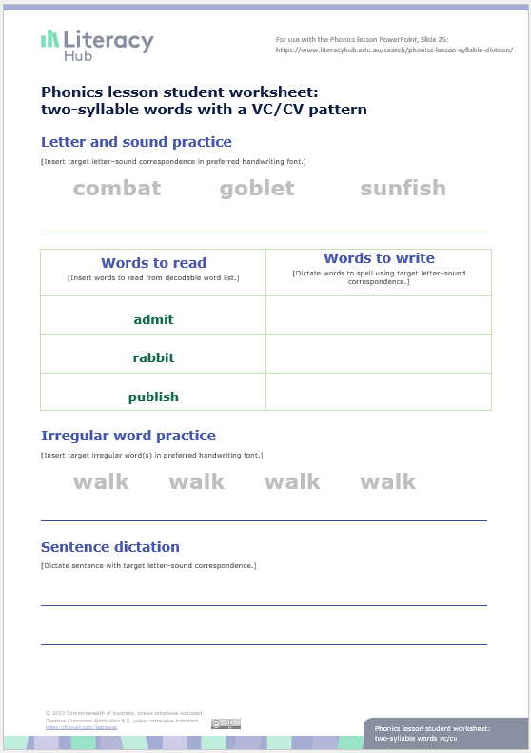
Check for understanding
Notes:
Students move to their desks or use clipboards on the floor space to complete this sheet independently. As students complete the worksheet, the teacher will monitor progress and make note of students who need to join a teacher-led focused teaching group.
This worksheet can be found on the Literacy Hub website: https://www.literacyhub.edu.au/search/phonics-lesson-student-worksheet-syllable-division-two-syllable-words-with-a-vc-cv-pattern/
For further examples of words and sentences, see the Literacy Hub’s decodable words and sentences document https://www.literacyhub.edu.au/search/decodable-words-and-sentences/; two syllable words with VC/CV pattern are covered in Phase 10 (page 12).
Syllable division practice
Students identify the VC/CV pattern and divide the word into two syllables by splitting between the two consonants.
Students read each syllable and combine syllables to read the whole word.
Words to read
The teacher roves around the class to listen to students whisper-reading one or more of the words from the worksheet.
Words to write
The teacher dictates three words with the target syllable types for students to segment and spell.
Irregular word practice
Students:
say the sounds in the word
circle the irregular part
write and say the word.
Sentence dictation
The teacher dictates a sentence with words containing the target syllable types for students to write.

Slide 27
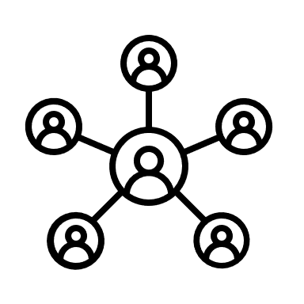


You do…
Focused teaching group
Independent practice
Notes:
Students who have been identified during the ‘check for understanding’ phase of the lesson stay with the teacher for small-group targeted instruction.
The remaining students continue independent practice with application tasks that have been taught previously and can be carried out independently.

Slide 28


