Slide 1
Mnemonics to support spelling
Notes:
The mnemonic words and phrases in this slide pack can be used to support students’ spelling. They have been collated from the phonics lessons in the Literacy Hub’s Phonics and morphology lesson packs (www.literacyhub.edu.au/plan-teach-assess/lesson-packs/). In these lessons, each mnemonic is explicitly taught in a complete, classroom-ready lesson.
The words and phrases mentioned on each slide align with the Literacy Hub Phonics progression (www.literacyhub.edu.au/search/literacy-hub-phonics-progression/).
The mnemonic words and phrases included in this slide pack support students’ knowledge around specific spelling generalisations, spelling patterns and alternative spelling sounds.
How to use this slide pack
The mnemonic words and phrases can be used in numerous ways to best suit your students and their needs. Some ideas are included below.
Review tools
Use the slides to review newly learnt spelling generalisations, spelling patterns or alternative spelling sounds.
Visual aids
Print copies to display as classroom posters for students to refer to.
Sets
Create small packs of selected slides and use as review sets.
Intervention
Use with small groups or in 1:1 intervention settings to support students with their spelling.

Slide 2

floss
ss
ll
ff
ff
zz
ll
ss
zz
floss
Notes:
Floss
Introduced in Phase 7, Lessons 1–4.
The floss mnemonic can help students remember the floss spelling generalisation: When a one-syllable word ends in f, l, s or z after a short vowel sound, the final consonant is doubled.

Slide 3

Sail away
Sail away
Notes:
Sail away
Introduced in Phase 11, Lesson 1.
The Sail away mnemonic phrase can help students remember the ai and ay spelling and their common positions in words:
ai says /ā/ in the middle and sometimes at the start of a word
ay says /ā/ at the end of a word.

Slide 4
The boat is slow
The boat is slow
Notes:
The boat is slow
Introduced in Phase 11, Lesson 3.
The boat is slow mnemonic phrase can help students remember the oa and ow spelling and their common positions in words:
oa says /ō/ in the middle and sometimes at the start of a word
ow says /ō/ at the end of a word.

Slide 5
Shy puppy
Shy puppy
Notes:
Shy puppy
Introduced in Phase 12, Lesson 3.
The Shy puppy mnemonic phrase can help students remember the final y spelling generalisation:
y says /ī/ at the end of a one-syllable word (with 2 or 3 letters)
y says /ē/ at the end of a word with two or more syllables (and usually more than three letters).

Slide 6
Eat bread. It’s great!
It’s great!
Eat bread
Notes:
Eat bread, it’s great!
Introduced in Phase 13, Lesson 1.
The Eat bread, it’s great! mnemonic phrase can help students remember the different sounds of ea:
most common: /ē/ as in eat
that’s why it is first in the mnemonic phrase, Eat bread, it’s great!
less common: /e/ as in bread
that’s why it is second in the mnemonic phrase, Eat bread, it’s great!
only in a few words: /ā/ as in great
that’s why it is last in the mnemonic phrase, Eat bread, it’s great!

Slide 7
I grew a few
I grew a few
Notes:
I grew a few
Introduced in Phase 13, Lesson 2.
The I grew a few mnemonic phrase can help students remember the two sounds of ew:
ew says /oo/ and /ū/
most common sound: /oo/ as in grew
that’s why it is first in the mnemonic phrase, I grew a few
less common sound: /ū/ as in few
that’s why it is second in the mnemonic phrase, I grew a few.

Slide 8
The statue is blue
The statue is blue
Notes:
The statue is blue
Introduced in Phase 13, Lesson 3.
The statue is blue mnemonic phrase can help students remember the two sounds of ue:
ue can say the long u sound. ue usually says /ū/ at the end of:
words with two or more syllables as in statue
words with a single consonant before ue as in due.
ue can say the /oo/ sound. ue usually says /oo/ at the end of:
one-syllable words after two or more consonant sounds as in blue.

Slide 9
Food is good
Food is good
Notes:
Food is good
Introduced in Phase 13, Lesson 4.
The Food is good mnemonic phrase can help students remember the two sounds of oo:
most common: /oo/ as in food
that’s why it is first in the mnemonic phrase, Food is good
less common: /ōō/ as in good
that’s why it is first in the mnemonic phrase, Food is good.

Slide 10
Boil the toy
Boil the toy
Notes:
Boil the toy
Introduced in Phase 14, Lesson 1.
The Boil the toy mnemonic phrase can help students remember the oi and oy spelling and their common positions in words:
oi is used in the middle and sometimes at the beginning of a word
oy is used at the end of a word.

Slide 11
Loud brown cow
Loud brown cow
Notes:
Loud brown cow
Introduced in Phase 14, Lesson 2.
The Loud brown cow mnemonic phrase can help students remember the ou and ow spelling and their common positions in words:
ou is used in the middle and sometimes at the beginning of a word
ow is used at the end of a word or in words where the /ow/ sound is followed by l, n or d.

Slide 12
Her bird is hurt
Her bird is hurt
Notes:
Her bird is hurt
Introduced in Phase 15, Lesson 5.
The Her bird is hurt mnemonic phrase can help students remember the different spellings for the /er/ r-controlled vowel sound:
er as in her
ir as in bird
ur as in hurt.

Slide 13
Gentle Cindy at the fence
Gentle Cindy at the fence
Notes:
Gentle Cindy at the fence
Introduced in Phase 17, Lessons 1 and 2.
The Gentle Cindy at the fence mnemonic phrase can help students remember the Gentle Cindy spelling generalisation:
g usually says a soft sound /j/ when followed by e, i or y, as in the first e of gentle.
c usually says a soft sound /s/ when followed by e, i or y, as in the i in Cindy
when words end in c and a final e, they end in the /s/ sound as in fence.

Slide 14
Pie thief
Pie thief
Notes:
Pie thief
Introduced in Phase 18, Lesson 1.
The Pie thief mnemonic phrase can help students remember the two sounds of ie:
ie says /ī/ at the end of short words, as in pie
ie says /ē/ in the middle of a word, as in thief.

Slide 15
That monkey is grey!
That monkey is grey!
Notes:
That monkey is grey!
Introduced in Phase 18, Lesson 2.
The That monkey is grey! mnemonic phrase can help students remember the two sounds of ey:
most common (especially in two-syllable words): ey says /ē/ as in monkey
that’s why it is first in the mnemonic phrase, That monkey is grey!
less common (and mostly in one-syllable words): ey says /ā/ as in grey
that’s why it is second in the mnemonic phrase, That monkey is grey!

Slide 16
Prawns with sauce
Prawns with sauce
Notes:
Prawns with sauce
Introduced in Phase 19, Lesson 1.
The Prawns with sauce mnemonic phrase can help students remember the au and aw spellings and their common positions in words:
most common: aw as in prawns
that's why it is first in the mnemonic phrase, Prawns with sauce
less common: au as in sauce
that’s why it is second in the mnemonic phrase, Prawns with sauce
au is more common than aw at the start of words as in automatic.

Slide 17
Hear the early bear
Hear the early bear
Notes:
Hear the early bear
Introduced in Phase 21, Lesson 2.
The Hear the early bear mnemonic phrase can help students remember the three sounds of ear:
most common: ear says /ear/ as in hear
that's why it is first in the mnemonic phrase, Hear the early bear
less common: ear says /er/ as in early
that's why it is second in the mnemonic phrase, Hear the early bear
least common: ear says /air/ as in bear
that's why it is last in the mnemonic phrase, Hear the early bear.

Slide 18
The swan is warm
The swan is warm
Notes:
The swan is warm
Introduced in Phase 22, Lesson 2.
The swan is warm mnemonic phrase can help students remember when a says the /o/ and /or/ sounds in words:
a usually says the /o/ sound after w
a can say the /or/ sound after w, usually when the a is followed by l or r.

Slide 19

The worm is working
The worm is working
Notes:
The worm is working
Introduced in Phase 22, Lesson 3.
The worm is working mnemonic phrase can help students remember when w-or says /w/, /er/, /wer/ as in worm and working.

Slide 20
Champ the Christmas chef
Champ the Christmas chef
Notes:
Champ the Christmas chef
Introduced in Phase 23, Lesson 1.
The Champ the Christmas chef mnemonic phrase can help students remember the three sounds of ch:
most common: ch says /ch/ as in champ
that's why it is first in the mnemonic phrase, Champ the Christmas chef
less common: ch says /k/ as in Christmas
that's why it is second in the mnemonic phrase, Champ the Christmas chef
least common: ch says /sh/ as in chef
that's why it is last in the mnemonic phrase, Champ the Christmas chef.

Slide 21

That’s a rough cough
That’s a rough cough!
Notes:
That’s a rough cough!
Introduced in Phase 24, Lesson 1.
The That’s a rough cough! mnemonic phrase can help students remember two of the seven common sounds of ough:
ough says /uff/, as in rough
ough says /off/, as in cough.

Slide 22
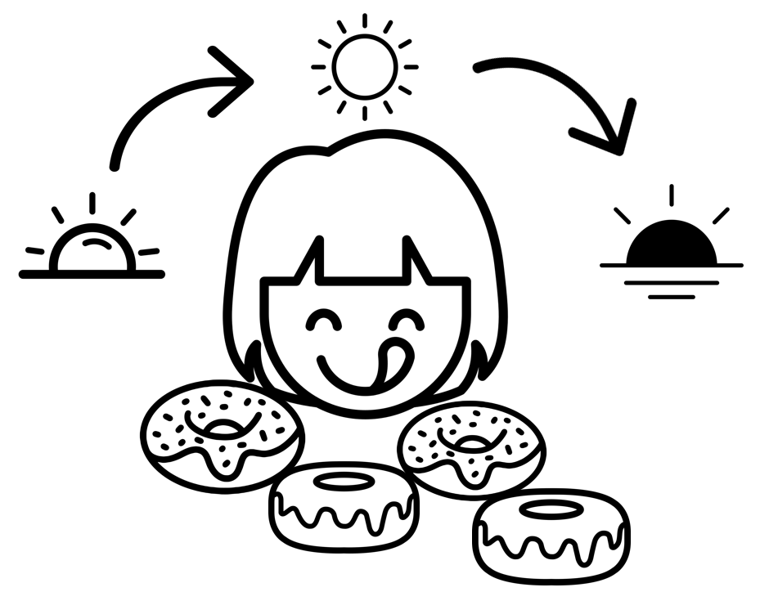
Eat doughnuts throughout the day
Eat doughnuts
throughout the day.
Notes:
Eat doughnuts throughout the day
Introduced in Phase 24, Lesson 2.
The Eat doughnuts throughout the day mnemonic phrase can help students remember two of the seven common sounds of ough:
ough says /ō/, as in doughnuts
ough says /oo/, as in throughout.

Slide 23
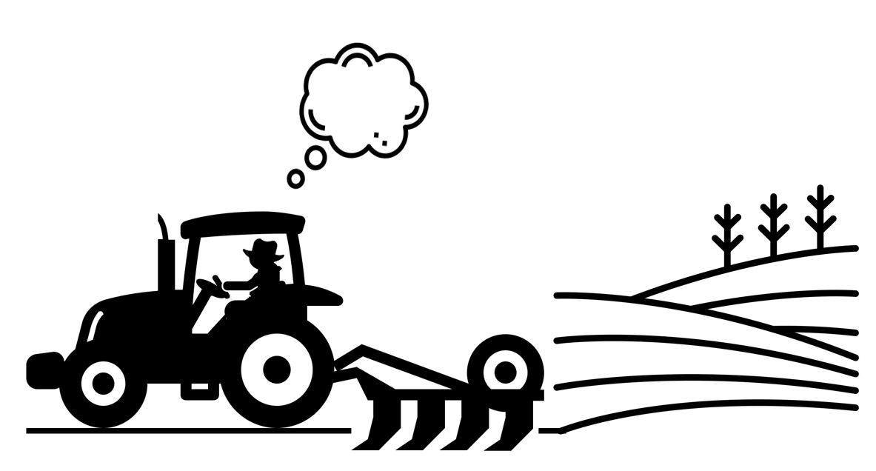
Plough the paddock thoughtfully and thoroughly
Plough the paddock thoughtfully and thoroughly.
Notes:
Plough the paddock thoughtfully and thoroughly
Introduced in Phase 24, Lesson 3.
The Plough the paddock thoughtfully and thoroughly mnemonic phrase can help students remember three of the seven common sounds of ough:
ough says /ow/, as in plough
ough says /or/, as in thoughtfully
ough says /ǝ/, as in thoroughly.

Slide 24
End of presentation

