Slide 1
Version 2, Oct 2023
Phonics
Spelling generalisation for letter–sound correspondences ai and ay Sail away
Instructions for teachers are included in the ‘notes’ section under each slide.

Slide 2
Notes for teachers
These slides show a sample of a systematic synthetic phonics lesson incorporating a spelling generalisation. The slides contain the following steps, aligned with an explicit instruction model:
1. Set learning intention and success criteria with students. (Slide 4)
2. I do: the teacher models writing the target graphemes while saying the phonemes and spelling generalisation. (Slide 5)
3. We do: the teacher and students write the target graphemes while saying the phonemes and spelling generalisation. (Slide 6)
4. I do: the teacher models decoding words with the target letter–sound correspondence and spelling generalisation. (Slides 7–9)
5. We do: the teacher and students decode words with the target letter–sound correspondence and spelling generalisation. (Slides 10–12)
6. I do: the teacher models encoding words with the target letter–sound correspondence and spelling generalisation. (Slides 13–15)
7. We do: the teacher and students encode words with the target letter–sound correspondence and spelling generalisation. (Slides 16–18)
8. I do: the teacher reads and spells a new irregular word. (Slide 19)
9. We do: the students read and spell the new irregular word. (Slide 20)
10. I do: the teacher models decoding a sentence containing words with the target letter–sound correspondence and spelling generalisation. (Slide 21)
11. We do: the teacher and students decode a sentence containing words with the target letter–sound correspondence and spelling generalisation. (Slide 22)
12. I do: the teacher models writing a sentence containing words with the target letter–sound correspondence and spelling generalisation. (Slide 23)
13. We do: the teacher and students write a sentence containing words with the target letter–sound correspondence and spelling generalisation. (Slide 24)
14. Check for understanding: students demonstrate their understanding by completing a task on a whiteboard or worksheet using the skills they have just learned. The teacher monitors to ensure understanding. (Slides 25–26)
15. You do: students complete an independent activity to apply the skills they have just learned. (Slide 27)

Slide 3
When you see these icons…
The teacher explicitly teaches and models (I do).
Students have something to fill out/write/draw.
The teacher guides students and provides immediate feedback (We do).
Students have something to look at/read.
‘Chin it’: students apply their learning by writing on a mini-whiteboard or worksheet or equivalent. They hold this under their chins so the teacher can monitor for student understanding.
Students apply their knowledge independently (You do).
Print a class set of worksheets to accompany this lesson: https://tinyurl.com/5388zd99

Slide 4
We are learning about letters and sounds so that we can read and write words.
Learning intention
Success criteria
I will know I have been successful if I can:
- say the sound for ai and ay
- read words with ai and ay
- write words with ai and ay
Notes:
The letter–sound correspondence introduced in this lesson is ai and ay making the long a sound, /ā/.
Spelling generalisation
ai says /ā/ in the middle and sometimes at the start of a word.
ay says /ā/ at the end of a word.
This slideshow uses the notation /ā/ to indicate the long a sound, as in ‘sail’ and ‘away’. It indicates the sound the students should make; the notation itself does not need to be taught to students.
The irregular word in this lesson is ‘their’. Irregular words are words containing letter–sound correspondences that students have not yet learned. These should be included as part of lessons, as students will need them early in their reading and writing development. The reading and writing of irregular words is not the primary focus for this lesson, so is not included in the success criteria.

Slide 5
I do…
Sail away
ai ai ai
ay ay ay
Notes:
Edit the grapheme to your preferred font.
Demonstrate tracing over the grapheme on the large screen while saying the target phoneme and spelling generalisation:
ai says /ā/ in the middle and sometimes at the start of a word
ay says /ā/ at the end of a word.

Slide 6
We do…
Sail away
ai ai ai
ay ay ay
Notes:
Students participate in forming the letter in the air, on the carpet or on a mini-whiteboard or equivalent, while saying the target phoneme and spelling generalisation:
ai says /ā/ in the middle and sometimes at the start of a word
ay says /ā/ at the end of a word.
Check that students are using the correct entry and exit points for their letter formation and offer feedback.

Slide 7
I do…
tail
Notes:
Model segmenting and blending sounds to read the word.
Explain to students that tail follows the ai spelling generalisation: ai makes the /ā/ sound in the middle of the word.

Slide 8
I do…
tail way
Notes:
Re-read the first word and then model segmenting and blending sounds to read the new word.
Explain to students that way follows the ay spelling generalisation: ay makes the /ā/ sound at the end of the word.

Slide 9
I do…
tail way pail
Notes:
Re-read the first two words and then model segmenting and blending sounds to read the new word.
Explain to students that pail follows the ai spelling generalisation: ai makes the /ā/ sound in the middle of the word.

Slide 10
We do…
hail
Notes:
Students participate in segmenting and blending sounds to read the word.
Ask students to explain how the word hail follows the ai spelling generalisation: ai makes the /ā/ sound in the middle of the word.

Slide 11
We do…
hail ray
Notes:
Students participate in re-reading the first word and segmenting and blending sounds to read the new word.
Ask students to explain how the word ray follows the ay spelling generalisation: ay makes the /ā/ sound at the end of the word.

Slide 12
We do…
hail ray fray
Notes:
Students participate in re-reading the first two words and segmenting and blending sounds to read the new word.
Ask students to explain how the word fray follows the ay spelling generalisation: ay makes the /ā/ sound at the end of the word.

Slide 13
I do…
Notes:
The image represents the word to be written: play.
Demonstrate saying the word aloud and then segmenting individual phonemes, recording the relevant graphemes as you do so.
Demonstrate re-reading the word to make sure it is correct. Check that the written word follows the ay spelling generalisation: ay makes the /ā/ sound at the end of the word.

Slide 14
I do…
Notes:
The images represent the words to be written: play, paint.
Demonstrate saying the words aloud and then segmenting individual phonemes, recording the relevant graphemes as you do so.
Demonstrate re-reading the new word to make sure it is correct. Check that the written word follows the ai spelling generalisation: ai makes the /ā/ sound in the middle of the word.

Slide 15
I do…
Notes:
The images represent the words to be written: play, paint, nails.
Demonstrate saying the words aloud and then segmenting individual phonemes, recording the relevant graphemes as you do so.
Demonstrate re-reading the new word to make sure it is correct. Check that the written word follows the ai spelling generalisation: ai makes the /ā/ sound in the middle of the word.

Slide 16
We do…
Notes:
The image represents the word to be written: rain.
Students participate in saying the word aloud and then segmenting individual phonemes with teacher support.
Students tell the teacher which graphemes to record to write the word on the board.
Students participate in re-reading the word to make sure it is correct while checking that the written word follows the ai spelling generalisation: ai makes the /ā/ sound in the middle of the word.

Slide 17
We do…
Notes:
The images represent the words to be written: rain, say.
Students participate in saying the words aloud and then segmenting individual phonemes with teacher support.
Students tell the teacher which graphemes to record to write the new word on the board.
Students participate in re-reading the new word to make sure it is correct while checking that the written word follows the ay spelling generalisation: ay makes the /ā/ sound at the end of the word.

Slide 18
We do…
Notes:
The images represent the words to be written: rain, say, day.
Students participate in saying the words aloud and then segmenting individual phonemes with teacher support.
Students tell the teacher which graphemes to record to write the new word on the board.
Students participate in re-reading the new word to make sure it is correct while checking that the written word follows the ay spelling generalisation: ay makes the /ā/ sound at the end of the word.

Slide 19
I do…
their their their
Notes:
Demonstrate the following steps to draw students’ attention to the internal structure of the irregular word, including letter–sound correspondences that have not yet been taught.
Tell students the word you are going to spell.
Use the word in a sentence for context, for example, ‘It was their drink bottle.’
Say each sound in the word.
On your teacher whiteboard, draw a short horizontal line for each sound in the word.
Write the corresponding letter on each sound line.
Circle the irregular part of the word, in this case the letters eir in ‘their’.
Spell the word orally, for example, ‘t-h-e-i-r spells their.’

Slide 20
We do…
their their their
Notes:
Prompt students to complete the process with you.
Tell students which word they are going to spell.
Use the word in a sentence.
Say the sounds.
Draw the sound lines.
Add the letters.
Circle the irregular part.
Spell the word.

Slide 21
I do…
May went for a swim in the bay.
Notes:
Model segmenting and blending sounds to read each word in the sentence.
Model re-reading the sentence with fluency.
Explain how the words May and bay follow the ay spelling generalisation: ay makes the /ā/ sound at the end of the word.

Slide 22
We do…
There was a snail in the mail.
Notes:
Students participate in segmenting and blending sounds to read each word in the sentence.
Students participate in re-reading the sentence with fluency.
Explain how the words snail and mail follow the ai spelling generalisation: ai makes the /ā/ sound in the middle of the word.

Slide 23
I do…
Notes:
Sentence dictation: We pay to go on the train.
Demonstrate saying the sentence aloud.
Model recording the sentence word by word, focusing each time on letter–sound correspondences, checking for accuracy.
Correct punctuation and spaces between words should also be explicitly taught during sentence dictation. Letter placement and formation can also be a focus here.
Model re-reading the whole sentence to check for accuracy or any editing required. Check that the words pay and train follow the ai/ay spelling generalisation:
ai says /ā/ in the middle and sometimes at the start of a word
ay says /ā/ at the end of a word.

Slide 24
We do…
Notes:
Sentence dictation: He saw a tail next to the hay.
Students participate in saying the sentence aloud.
Students participate in segmenting phonemes in words and directing the teacher to write the corresponding graphemes word by word.
Students also participate in prompting the teacher to:
include correct punctuation and spaces between words
use correct letter placement and formation.
Students participate in re-reading the entire sentence to check for accuracy or any editing required. Students check that the words tail and hay follow the ai/ay spelling generalisation:
ai says /ā/ in the middle and sometimes at the start of a word
ay says /ā/ at the end of a word.

Slide 25
Check for understanding
I can…
say the sound for
ai and ay
read words with ai and ay
write words with ai and ay
ray
pain
brain
Notes:
Refer to the success criteria.
I will know I have been successful if I can:
say the sound for /ai/ and /ay/
read words with /ai/ and /ay/
write words with /ai/ and /ay/.
Note: students who have not met the success criteria are top priority for small-group targeted instruction.
The teacher writes a word on the board for students to read. Then, students write a word dictated by the teacher on their mini-whiteboard or equivalent, and they ’chin it’ (see Slide 2).

Slide 26
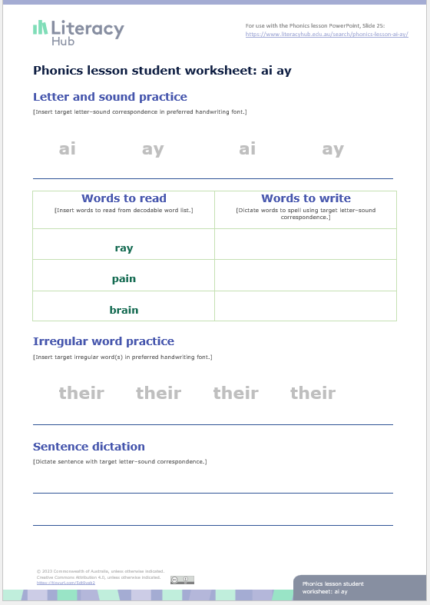
Check for understanding
Notes:
Students move to their desks or use clipboards on the floor space to complete this sheet independently. As students complete the worksheet, the teacher will monitor progress and make note of students who need to join a teacher-led focused teaching group.
This worksheet can be found on the Literacy Hub website: https://www.literacyhub.edu.au/search/phonics-lesson-student-worksheet-spelling-generalisation-for-letter-sound-correspondences-ai-ay/
For further examples of words and sentences, see the Literacy Hub’s decodable words and sentences document https://www.literacyhub.edu.au/search/decodable-words-and-sentences/; ai/ay is covered in Phase 11 (pages 13–14).
Letter and sound practice
Students write each letter/letter pattern while saying the sound that represents it.
Words to read
The teacher roves around the class to listen to students whisper-reading one or more of the words from the worksheet.
Words to write
The teacher dictates three words with the target letter-sound correspondence for students to segment and spell.
Irregular word practice
Students:
say the sounds in the word
circle the irregular part
write and say the word.
Sentence dictation
The teacher dictates a sentence with words containing the target letter-sound correspondence for students to write.

Slide 27
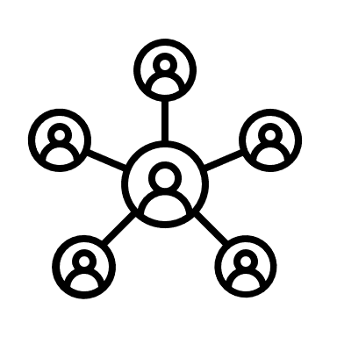
You do…
Focused teaching group
Independent practice
Notes:
Students who have been identified during the ‘check for understanding’ phase of the lesson stay with the teacher for small-group targeted instruction.
The remaining students continue independent practice with application tasks that have been taught previously and can be carried out independently.

