Slide 1

Version 2, Oct 2023
Phonics
Spelling generalisation for ff ll ss zz
Floss
Instructions for teachers are included in the ‘notes’ section under each slide.

Slide 2
Notes for teachers
These slides show a sample of a systematic synthetic phonics lesson incorporating a spelling generalisation. The slides contain the following steps, aligned with an explicit instruction model:
1. Set learning intention and success criteria with students. (Slide 4)
2. I do: the teacher models writing the target graphemes while saying the phonemes and spelling generalisation. (Slide 5)
3. We do: the teacher and students write the target graphemes while saying the phonemes and spelling generalisation. (Slide 6)
4. I do: the teacher models decoding words with the target letter–sound correspondence and spelling generalisation. (Slides 7–9)
5. We do: the teacher and students decode words with the target letter–sound correspondence and spelling generalisation. (Slides 10–12)
6. I do: the teacher models encoding words with the target letter–sound correspondence and spelling generalisation. (Slides 13–15)
7. We do: the teacher and students encode words with the target letter–sound correspondence and spelling generalisation. (Slides 16–18)
8. I do: the teacher reads and spells a new irregular word. (Slide 19)
9. We do: the students read and spell the new irregular word. (Slide 20)
10. I do: the teacher models decoding a sentence containing words with the target letter–sound correspondence and spelling generalisation. (Slide 21)
11. We do: the teacher and students decode a sentence containing words with the target letter–sound correspondence and spelling generalisation. (Slide 22)
12. I do: the teacher models writing a sentence containing words with the target letter–sound correspondence and spelling generalisation. (Slide 23)
13. We do: the teacher and students write a sentence containing words with the target letter–sound correspondence and spelling generalisation. (Slide 24)
14. Check for understanding: students demonstrate their understanding by completing a task on a whiteboard or worksheet using the skills they have just learned. The teacher monitors to ensure understanding. (Slides 25–26)
15. You do: students complete an independent activity to apply the skills they have just learned. (Slide 27)

Slide 3







When you see these icons…
The teacher explicitly teaches and models (I do).
Students have something to fill out/write/draw.
The teacher guides students and provides immediate feedback (We do).
Students have something to look at/read.
‘Chin it’: students apply their learning by writing on a mini-whiteboard or worksheet or equivalent. They hold this under their chins so the teacher can monitor for student understanding.
Students apply their knowledge independently (You do).
Print a class set of worksheets to accompany this lesson: https://tinyurl.com/mr2hefnt

Slide 4
We are learning about letters and sounds so that we can read and write words.
Learning intention
Success criteria
I will know I have been successful if I can:
identify when the ‘floss’ pattern is used
read words with the ‘floss’ pattern
write words with the ‘floss’ pattern.
Notes:
The letter–sound correspondence introduced in this lesson is ff making a /f/ sound, ll making a /l/ sound, ss making a /s/ sound and zz making a /z/ sound.
Spelling generalisation
When a one-syllable word ends in f, l, s or z after a short vowel, the final consonant is doubled.
Remember this pattern using the word ‘floss’.
The irregular word in this lesson is ‘where’. Irregular words are words containing letter–sound correspondences that students have not yet learned. These should be included as part of lessons, as students will need them early in their reading and writing development. The reading and writing of irregular words is not the primary focus for this lesson, so is not included in the success criteria.

Slide 5

I do…
Floss
ff ll
ss zz
Notes:
Edit the grapheme to your preferred font.
Demonstrate tracing over the grapheme on the large screen while saying each target phoneme.

Slide 6

We do…
Floss
ff ll
ss zz
Notes:
Students participate in forming the letters in the air, on the carpet or on a mini-whiteboard or equivalent while saying each target phoneme.
Check that students are using the correct entry and exit points for letter formation and offer feedback.

Slide 7
I do…
toss
Notes:
Model segmenting and blending sounds to read the word.
Explain how the word toss follows the ‘floss’ spelling generalisation: the letter s at the end has been doubled because it follows a short vowel sound.

Slide 8
I do…
toss press
Notes:
Re-read the first word, then model segmenting and blending sounds to read the new word.
Explain how the word press follows the ‘floss’ spelling generalisation: the final letter s is doubled as it follows a short vowel sound.

Slide 9
I do…
toss press stiff
Notes:
Re-read the first two words and then model segmenting and blending sounds to read the new word.
Explain how the word stiff follows the ‘floss’ spelling generalisation: the final letter f is doubled as it follows a short vowel sound.

Slide 10
We do…
fuzz
Notes:
Students participate in segmenting and blending sounds to read the word.
Ask students to explain how the word fuzz follows the ‘floss’ spelling generalisation: the final letter z is doubled as it follows a short vowel sound.

Slide 11
We do…
fuzz doll
Notes:
Students participate in re-reading the first word and segmenting and blending sounds to read the new word.
Ask students to explain how the word doll follows the ‘floss’ spelling generalisation: the final letter l is doubled as it follows a short vowel sound.

Slide 12
We do…
fuzz doll smell
Notes:
Students participate in re-reading the first two words and segmenting and blending sounds to read the new word.
Ask students to explain how the word smell follows the ‘floss’ spelling generalisation: the final letter l is doubled as it follows a short vowel sound.

Slide 13

I do…
Notes:
The image represents the word to be written: sniff.
Demonstrate saying the word aloud and then segmenting individual phonemes, recording the relevant graphemes as you do so.
Demonstrate re-reading the word to make sure it is correct. Check that the written word follows the ‘floss’ spelling generalisation: the final letter f is doubled as it follows a short vowel sound.

Slide 14

I do…
Notes:
The images represent the words to be written: sniff, bell.
Demonstrate saying the words aloud and then segmenting individual phonemes, recording the relevant graphemes as you do so.
Demonstrate re-reading the new word to make sure it is correct. Check that the written word follows the ‘floss’ spelling generalisation: the final letter l is doubled as it follows a short vowel sound.

Slide 15

I do…
Notes:
The images represent the words to be written: sniff, bell, cross.
Demonstrate saying the words aloud and then segmenting individual phonemes, recording the relevant graphemes as you do so.
Demonstrate re-reading the new word to make sure it is correct. Check that the written word follows the ‘floss’ spelling generalisation: the final letter s is doubled as it follows a short vowel sound.

Slide 16

We do…
Z
z
z
Notes:
The image represents the word to be written: buzz.
Students participate in saying the word aloud and then segmenting individual phonemes with teacher support.
Students tell the teacher which graphemes to record to write the word on the board.
Students participate in re-reading the word to make sure it is correct while checking that the written word follows the ‘floss’ spelling generalisation: the final letter z is doubled as it follows a short vowel sound.

Slide 17

We do…
Z
z
z
S
s
s
Notes:
The images represent the words to be written: buzz, hiss.
Students participate in saying the words aloud and then segmenting individual phonemes with teacher support.
Students tell the teacher which graphemes to record to write the new word on the board.
Students participate in re-reading the new word to make sure it is correct while checking that the written word follows the ‘floss’ spelling generalisation: the final letter s is doubled as it follows a short vowel sound.

Slide 18

We do…
Z
z
z
S
s
s
Notes:
The images represent the words to be written: buzz, hiss, spill.
Students participate in saying the words aloud and then segmenting individual phonemes with teacher support.
Students tell the teacher which graphemes to record to write the new word on the board.
Students participate in re-reading the new word to make sure it is correct while checking that the written word follows the ‘floss’ spelling generalisation: the final letter l is doubled as it follows a short vowel sound.

Slide 19
I do…
where where where
Notes:
Demonstrate the following steps to draw students’ attention to the internal structure of the irregular word, including letter–sound correspondences that have not yet been taught.
Tell students the word you are going to spell.
Use the word in a sentence for context, for example, ‘Where is your bag?’
Say each sound in the word.
On your teacher whiteboard, draw a short horizontal line for each sound in the word.
Write the corresponding letter on each sound line.
Circle the irregular part of the word, in this case the letters ere in ‘where’.
Spell the word orally, for example, ‘w-h-e-r-e spells where.’

Slide 20
We do…
where where where
Notes:
Prompt students to complete the process with you.
Tell students which word they are going to spell.
Use the word in a sentence.
Say the sounds.
Draw the sound lines.
Add the letters.
Circle the irregular part.
Spell the word.

Slide 21
I do…
What a mess!
Notes:
Model segmenting and blending sounds to read each word in the sentence.
Model re-reading the sentence with fluency.
Explain how the word mess follows the ‘floss’ spelling generalisation: the final letter s is doubled as it follows a short vowel sound.

Slide 22
We do…
I had to toss the
bag to Will.
Notes:
Students participate in segmenting and blending sounds to read each word in the sentence.
Students participate in re-reading the sentence with fluency.
Ask students to explain how the words toss and Will follow the ‘floss’ spelling generalisation: the final letters s and l are doubled as they follow a short vowel sound.

Slide 23

I do…
Notes:
Sentence dictation: I like the frill on your dress.
Demonstrate saying the sentence aloud.
Model recording the sentence word by word, focusing each time on letter–sound correspondences, checking for accuracy.
Correct punctuation and spaces between words should also be explicitly taught during sentence dictation. Letter placement and formation can also be a focus here.
Model re-reading the whole sentence to check for accuracy or any editing required. Check that the words frill and dress follow the ‘floss’ spelling generalisation: the final letters l and s are doubled as they follow a short vowel sound.

Slide 24
We do…
Notes:
Sentence dictation: Lan had a tiff with Jill on the hill.
Students participate in saying the sentence aloud.
Students participate in segmenting phonemes in words and directing the teacher to write the corresponding graphemes word by word.
Students also participate in prompting the teacher to:
include correct punctuation and spaces between words
use correct letter placement and formation.
Students participate in re-reading the entire sentence to check for accuracy or any editing required. Students check that the words tiff, Jill and hill follow the ‘floss’ spelling generalisation: the final letters f and l are doubled as they follow a short vowel sound.

Slide 25


Check for understanding
say the sound for
ff ll ss zz
read a word with
ff ll ss zz
write a word with ff ll ss zz
I can…
off
fizz
bless
hill
Notes:
Refer to the success criteria.
I will know I have been successful if I can:
say the sounds for /ff/ /ll/ /ss/ /zz/
read words with /ff/ /ll/ /ss/ /zz/
write words with /ff/ /ll/ /ss/ /zz/.
Note: students who have not met the success criteria are top priority for small-group targeted instruction.
The teacher writes a word on the board for students to read. Then, students write a word dictated by the teacher on their mini-whiteboard or equivalent, and they ’chin it’ (see Slide 2).

Slide 26
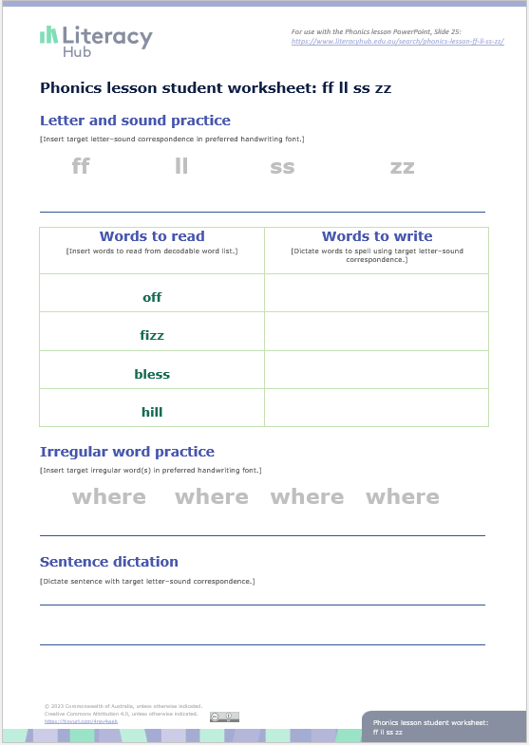
Check for understanding
Notes:
Students move to their desks or use clipboards on the floor space to complete this sheet independently. As students complete the worksheet, the teacher will monitor progress and make note of students who need to join a teacher-led focused teaching group.
This worksheet can be found on the Literacy Hub website: https://www.literacyhub.edu.au/search/phonics-lesson-student-worksheet-spelling-generalisation-for-ff-ll-ss-zz/
For further examples of words and sentences, see the Literacy Hub’s decodable words and sentences document https://www.literacyhub.edu.au/search/decodable-words-and-sentences/; ff ll ss zz is covered in Phase 7 (page 8).
Letter and sound practice
Students write each letter/letter pattern while saying the sound that represents it.
Words to read
The teacher roves around the class to listen to students whisper-reading one or more of the words from the worksheet.
Words to write
The teacher dictates three words with the target letter-sound correspondence for students to segment and spell.
Irregular word practice
Students:
say the sounds in the word
circle the irregular part
write and say the word.
Sentence dictation
The teacher dictates a sentence with words containing the target letter-sound correspondence for students to write.

Slide 27



You do…
Focused teaching group
Independent practice
Notes:
Students who have been identified during the ‘check for understanding’ phase of the lesson stay with the teacher for small-group targeted instruction.
The remaining students continue independent practice with application tasks that have been taught previously and can be carried out independently.

Slide 28


